Slide 1
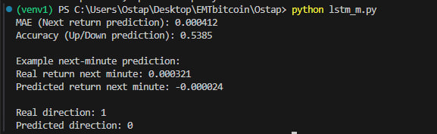
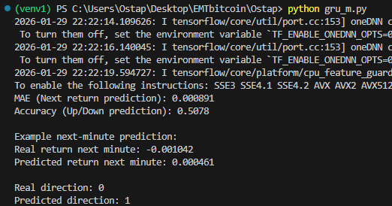
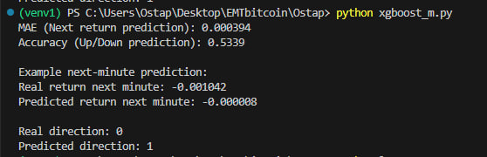
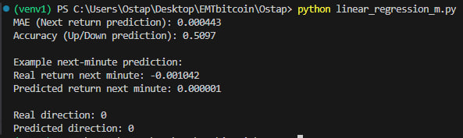
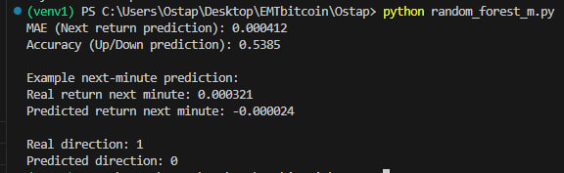
Prediction Results

Slide 2
Model Performance Metrics. EVALUATION OF ML MODELS
Model | MAE (Next Return) | Directional Accuracy
LSTM | 0.000412 | 53.85%
Random Forest | 0.000412 | 53.85%
XGBoost | 0.000394 | 53.39%
Linear Regression | 0.000443 | 50.97%
GRU | 0.000891 | 50.78%
Key Insight: * Non-linear models (LSTM, RF, XGBoost) outperformed Linear Regression (50.97%).
Results indicate a persistent, though narrow, predictive signal in historical BTC data.

Slide 3
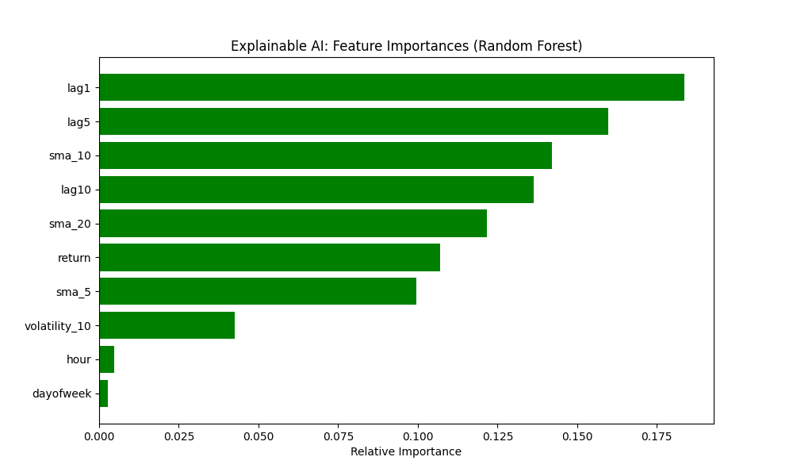

Slide 4
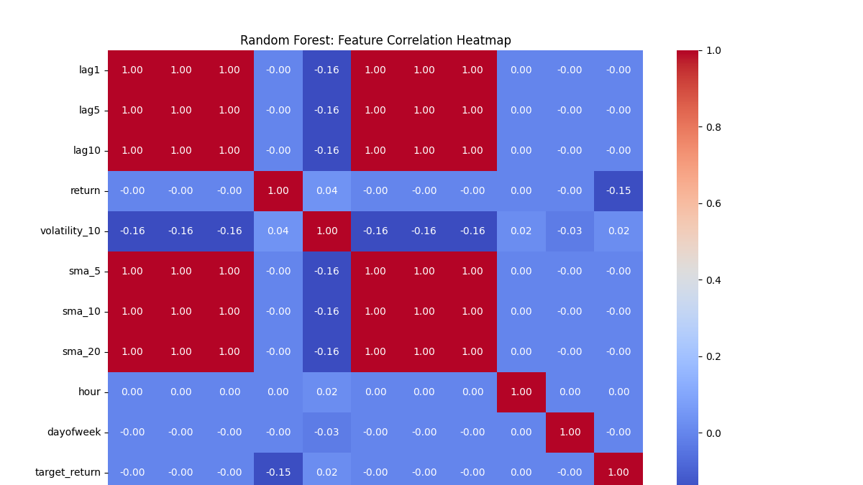

Slide 5
IMPLICATIONS FOR BTC MARKET EFFICIENCY
EMH Verdict:
Reject Weak-Form Efficiency: Models successfully used past prices to predict future direction with >53% accuracy.
Historical information is not fully reflected in current prices, contradicting the strict EMH.
Practical Outlook:
The ~3.8% edge over random guessing suggests the BTC market is "Incomplete" or "Semi-Weak" in its efficiency.
Profitability in real-world trading would still depend on transaction costs and execution speed.

